Slide 1
SSD Parent Advisory Council
PAC & SSD Meeting
February 14, 2024

Slide 2
Agenda Topics
Update from PAC President
Update on District Events - Dr. Maclin
Legislative Update
Family and Community Engagement
Alternative to Guardianship in Missouri

Slide 3
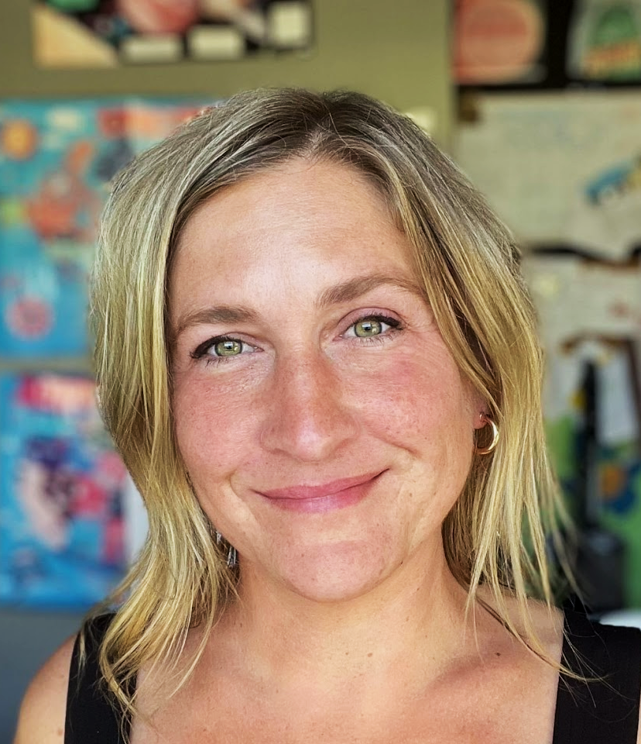
PAC President Update
Rebecca Flieg, PAC President

Slide 4
February Updates
March: no meeting
April 10: PAC Member voting
May 8: EC Voting, End of Year party
SSD PAC/FACE Survey

Slide 5
Tonight’s Topic- Why?
A story about an IEP & 504
What is the goal? Do parents know? Do the children?
Empower all stakeholders with actionable, shared goal. What wonderful progress could be made?

Slide 6
Old New
Institutions, group homes Living Independently in own community
Sheltered Workshops C.I.E. (Competitive Integrated Employment)
The Four F’s Can and do work in all sectors
Segregation in schools Inclusive Education
Decisions made by others Person Centered Planning
No voice, no choice Self-determination
Guardianship Supported decision-making

Slide 7
98% Of youth with a disability expect to have a paid job
89% of people with disabilities are unemployed or underemployed
66% live in poverty
Approximately 80% of women and 30% Of men with DD have been sexually assaulted--half of these women have been assaulted more than 10 times
Students who are expected to work are 5Xs more likely to have a paid job in the community after high school
54% are not involved in their community
BJS-Crimes Against Persons with Disabilities (2014)
www.disabilitycompendium.org (2017)

Slide 8
People with Greater Self-Determination are:
Healthier
More independent
More well adjusted
Better able to recognize and resist abuse
(Khemka, Hickson, & Reynolds, 2005; O’Connor & Vallerand, 1994; Wehmeyer & Schwartz, 1997 & 1998; Powers et al., 2012; Shogren et al., 2014; Wehmeyer & Palmer, 2003

Slide 9
‘Pathway to Self-Determination’

Slide 10
Initiative: Pathway to Self-Determination
Goal: Partner District Engagement, Family Support, Student Success
Set goal
Update highest goal for disabled students (exceeds sheltered workshops, guardianship)
Provide paid calendar time before start of year for Gen Ed/SSD collaboration
Student-led, student-participation in IEP/504, “i” goals- DESE
Solve problem of lack of access to typical athletics/extracurriculars
Inclusion push in k-5 with intent of developing natural support
Unstructured, low pressure social time gains priority
Increase focus and collaboration on Assistive Tech
Ensure transcripts and diplomas reflect increasing postsecondary opportunities
Equity check on home school communications to ensure equal access to Gen Ed/ Whole School communications

Slide 11
Initiative: Pathway to Self-Determination
Equity check on Tech access to Gen Ed norms (Chromebooks, Canvas, ParentSquare, photos)
Engage Partner District Counseling, Athletic Directors, PTO/PSO’s, DEIA
“INTRO TO SPED KIT”, if created, would cover:
Provide strong introduction to dual district system by the Partner District(PD)
‘Family Navigation Form’ to fill out SSD & Gen Ed teachers/ hierarchies of the student
Information provided on timeline, introduction through transition, 18+, VSP
ABLE account information, Post-Secondary information
SSD FACE, SSD PAC introduction and information
Ability for Districts to add their own inclusive programs, activities, adaptive playgrounds, etc
Introduction (links) to vital community & state resources

Slide 12
How can this help my child?

Slide 13
Examples
Problem: My SSD teacher doesn’t know how to implement Self-Determination
Problem: Student with one on one help graduates dependent on prompts or adult help to navigate the world.
Problem: Teachers speak over my child. Sometimes they say negative things in front of my child, as if they don’t understand or feel. They don’t ask my child direct questions, permission to invade personal space, or inform them directly about what is happening.
Problem: Student is drilled to follow direction. Student ends up obeying adults without question in daily life ‘Lay down’ ‘follow me’. Following orders is taught above decision making and self-advocacy
Problem: Student is so closely monitored and quickly redirected that they don’t have the chance to attempt or try, fail, and gain experience. No ‘opportunity to fail’. How can this be prevented?

Slide 14
Self-Determination Tips
Have them request needed/wanted items
Set an expectation that they will consistently demonstrate/use skills that they have as independently as possible
Parents model language that they need to make requests
Chores
Order for themselves at a restaurant
Order for everyone at a restaurant
Teach them to email teachers with questions or concerns (even if they are yours)
Teach them how to stand in line and buy something at a store
Plan/Cook a meal together including the grocery store experience
Teach them to advocate for their needs with teachers and others
During the IEP Process:
Advocate for your student to participate
Advocate for goals in:
Differentiated communication (emailing teachers, parents, etc)
Student communicating accommodations/modifications to teachers
Self advocacy for wants/needs
Student asking for support to complete assignments from trusted peer
“I” goals
Fade & Decrease adult support
Practice things independently
Navigate school independently
Teachers can use Goal book for IEP goals

Slide 15
QUESTIONS

Slide 16
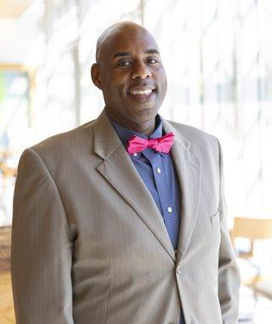
Superintendent Update
Dr. Michael Maclin, SSD Superintendent

Slide 17
Superintendent Update
Updates
Preparing budget and staffing for next year
Celebrating Black History Month activities taking place throughout the county
Highlighting students and programs on social media for Career and Tech Ed Month
Planning for our first in-person student awards ceremony since COVID. Honorees and event details coming soon.
Upcoming Events
Board of Education Election at March 4 Governing Council meeting
Family Academy, Feb. 24, 9 AM - 12 PM
- Neuwoehner High School
STL Career and Pathways Showcase
- Eureka High School, Feb. 24, 10 AM - 1 PM
- North Tech, March 2, 10 AM - 1 PM
- South Tech, March 9, 10 AM - 1 PM
Notes:
Board of Education Election - 3 candidates
Subdistrict 5 – Brentwood, Kirkwood, Lindbergh, Valley Park, and Webster Groves school districts
Mr. Joe Sartorius (resides in Lindbergh Schools)
Subdistrict 6 – Ladue, Normandy, Ritenour, and University City school districts
Ms. Joanne Soudah (resides in School District of University City)
Ms. Tiffany Hudson - Incumbent (resides in School District of University City)
Budget and staffing for next year
Working with leaders to prepare for next school year
Staff Award Nominations Due 01/15/24 - Families can submit nominations for staff
5 Categories: Key to the Classroom (teachers), Building Block (paras, OT/PT, COTA, aides), Distinguished Leader (SSD Leader, SSD Leader in Partner District, and Partner District Staff Leader), Lasting Impression (support staff, operations, instructional staff that are not teachers), Special Ambassadors (community partners)
Planning for summer programming - details coming soon
Preparing for winter weather - keeping an eye on forecasted weather to ensure we can safely hold class
STL Career and Pathways Showcase
2/24 @ Eureka HS
3/2 @ North Tech
3/9 @South Tech
Family Survey Available Now Open - closes on Jan. 26
2 versions - one for family receiving special education services and the other for families with students in CTE

Slide 18
Legislative Update - Bills Filed
HB1663 - Tara Peters - Partial consent to services
https://house.mo.gov/Bill.aspx?bill=HB1663&year=2024&code=R
SB812 - parental consent for placements/removals/ additions/changes/reductions of services in the IEP (2 HB and 1 SB)
https://www.senate.mo.gov/24info/BTS_Web/Bill.aspx?SessionType=R&BillID=191

Slide 19
Family And Community Engagement Update
Adrienne Eaglin, FACE Manager

Slide 20
Recreation Council of Greater St. Louis along with many of their VENDORS will present information regarding programs and recreations options for families.

Slide 21
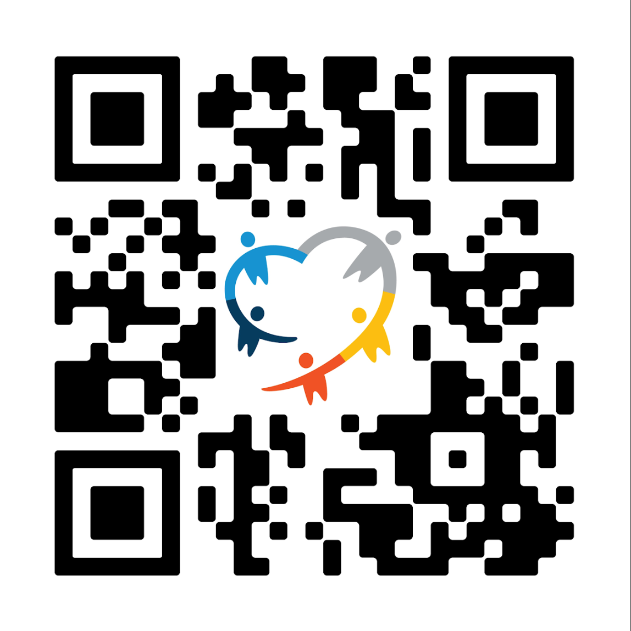
Hulmes Resources on February 28th from 11:30 to noon
March 1st
12- 2 PM and 10 - 2 PM

Slide 22
Support Available
email: face@ssdmo.org
SSD YOUTUBE PLAYLIST - FACE WORKSHOPS
SSD Departments Directory

Slide 23
ALTERNATIVES TO GUARDIANSHIP PROJECT IN MISSOURI
EMPOWERING INDIVIDUALS AND FAMILIES THROUGH SUPPORT AND EDUCATION

Slide 24
BACKGROUND/HISTORY
Jennifer Hulme- Founder/Executive Director of Hulme Resources Inc.
30+ years of experience in the field
Hulme Resources Inc began providing services for individuals with I/DD in 2021
Awarded 2 grants from Missouri Developmental Disabilities Council (MODDC) in June 2022
Consultation and Mediation
Training and Resources

Slide 25
MISSOURI UNDER THE MICROSCOPE

Slide 26
THE DREADED “PIPELINE” REFERENCE…
Like it or not, the schools ARE the beginning of the guardianship pipeline
Educators are NOT to be expected to be the experts on guardianship
Educators DO need to know where to direct students and their families
Educators DO need to incorporate more options for Supported Decision Making in the classroom as early as possible
Students DO need to become educated in their options, and provided in PLAIN LANGUAGE
Families DO need to know the consequences and long term effects of guardianship
It may take a change in legislation to include alternatives to guardianship info in the “Age of Majority” letter that is sent home.

Slide 27
WHAT DOES OUR ATG PROJECT ACTUALLY PROVIDE?
Short term supports with understanding the ins and outs of guardianship AND it’s alternatives
In certain cases will help draw up Power of Attorney Paperwork
Provide support in developing and implementing a Supported Decision Making plan
Provide referrals to more formal legal resources if needed
Provide “Train the trainer” opportunities for school districts, through RPDC’s Provide training to specific districts on request
Build capacity across the state for a bigger knowledge base

Slide 28
HOW CAN A STUDENT, FAMILY, OR EDUCATOR PARTICIPATE IN THIS PROJECT?
Scan QR code and fill out referral form
OR email info@hulmeresources.com

Slide 29
Supported Decision-Making
and Alternatives to
Guardianship
SSD Parent Advisory Council
Debra Fiasco, Administrator
SSD Family and Community Engagement
Notes:
Sharon Spurlock
Senior Director of Family Education
St. Louis Arc

Slide 30
What Is Our Goal?
To empower individuals
with developmental disabilities or special healthcare needs, their families, and key supporters to make informed decisions as they
consider options and alternatives
for achieving an
appropriate level of support and/or protection.

Slide 31
What We Know
There is NO
“one size fits all”
for
Alternatives to Guardianship
or method of
Supported Decision-Making.

Slide 32
Why Do Families Consider Guardianship?
Worried about the well-being of someone they care about
being at risk of being taken advantage of by others;
A student with a developmental disability or special
healthcare need is about to reach the age of 18; and
Recommended by a professional, friend or family member
that they need guardianship to maintain their rights
to provide support and/or protection.
Notes:
Guardianship is when a judge decides that a person with a disability cant make their own decisions. The judge chooses a guardian is someone who makes decisions for the student.

Slide 33
Transfer of Rights
Transfer of rights: At least one year before your child turns 18, the age of majority in Missouri, the IEP must include a statement that your child has been informed of his or her rights that will transfer to him or her at age 18.
If your student is still a dependent under Internal Revenue Service rules (living at home and supported by you), you still have the right to receive copies of any notices given to your child, to attend IEP meetings, and to access your child’s educational records.
When your student turns 18, the district will notify you that the transfer of rights has occurred.
Department of Elementary & Secondary Education: Parent’s Guide to Special Education, page 13, Transfer of Rights.

Slide 34
Life Experience = Risks
Notes:
Adrienne I am seeking a better photo for this slide. LAM

Slide 35
Self-Determination Is:
FREEDOM to choose.
SUPPORT the ability to organize in ways that are unique to the individual.
RESPONSIBILITY to contribute to one’s community.
EMPOWERS by focusing on the desires and abilities of the individual.
RESPECTFUL of the individual.

Slide 36
What Research Tells Us
People with intellectual and developmental disabilities who do not have a guardian are more likely to:
Have a paid job
Live independently
Have friends other than staff or family
Go on dates and socialize in the community
Practice the Religion of their choice
2013-2014 National Core Indicators

Slide 37
Missouri Guardianship Law
The court must consider whether the respondent’s needs may be met without the necessity of the appointment of a guardian or conservator, or both, by a less restrictive alternative.
Less restrictive alternatives include, but are not limited to:
Evidence that the respondent has appointed an attorney-in-fact in a durable power of attorney;
The management of the beneficial interests of the respondent in a trust by a trustee;
Evidence that a representative payee has been appointed to manage the respondent’s public benefits;
Supported decision-making agreements or the provision of protective or supportive services or arrangements provided by individuals or public or private services or agencies;
The use of appropriate services or assistive technology;
The appointment of a temporary emergency guardian ad litem or conservator ad litem; and
The appointment of a limited guardian or conservator.

Slide 38
Supported Decision-Making
“Alternatives to guardianship, including supported decision making, should always be identified and considered whenever possible prior to the commencement of guardianship proceedings.”
National Guardianship Association
“Position Statement on Guardianship, Surrogate Decision Making and Supported Decision Making” (2015)
Jonathan Martinis
Supported Decision Making in Action: Timberley and Tonya's Story (Video)

Slide 39
Charting The LifeCourse (CtLC)
Lifecoursetools.com is a project of Missouri Family to Family. Missouri Family to Family is housed within Missouri’s University Center for Excellence in Developmental Disabilities Education, Research and Services (UCEDD) at the University of Missouri–Kansas City Institute for Human Development.
Notes:
May need to cut some of this section due to time constraints

Slide 40
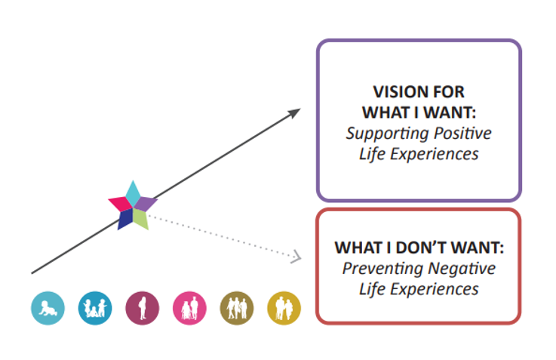
Planning for the Future

Slide 41
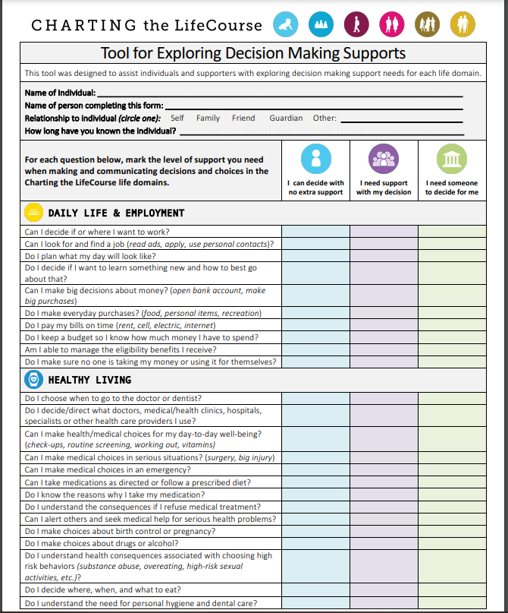
Where Do I Start?
Decision Making
Assessment
IDENTIFYING AREAS OF NEED FOR SUPPORT AND/OR ACCOMMODATION

Slide 42
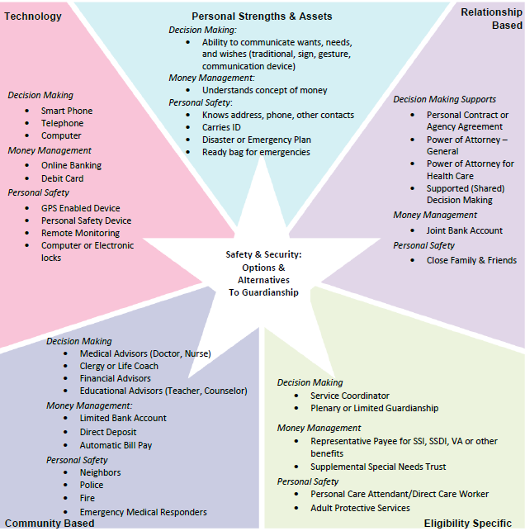
Planning for Safety and Security
The Integrated Support Star can be used to think about different
kinds of supports to help your student with making choices and decisions, and supports for communicating their decisions to others.

Slide 43
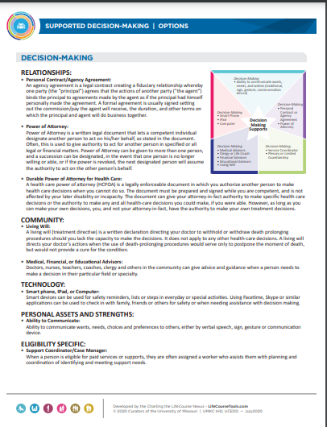
Supported Decision-Making Tip Sheet
Explore different options for supporting someone to make decisions and choices, organized using the Charting the LifeCourse Integrated Supports Star. Strategies for money management, personal safety, and general decision-making supports are listed and explained.

Slide 44
Supported Decision-Making Agreement

Slide 45
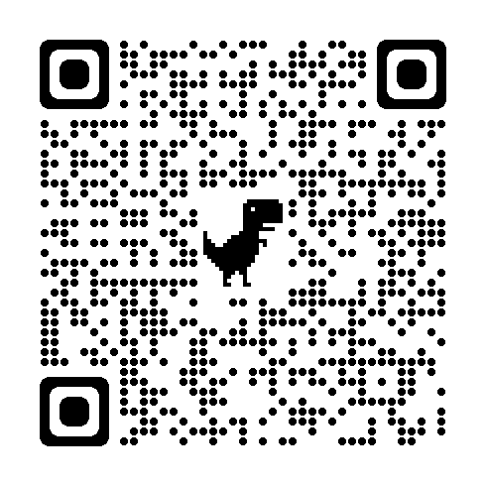
Charting The LifeCourse Supported Decision-Making
Notes:
this site takes the user to a community of learning, pulling together all the tools discussed in the previous slides

Slide 46
Other Tools and Resources
Durable Power of Attorney
Durable Power of Attorney for Health Care
Living Will
Living Trust
Special Needs Trust
Adult Protective Services
MOguardianship.com
http://www.arcofmissouri.org/news-events.htm
SupportedDecisionMaking.org

Slide 47
Power of Attorney
A Power of Attorney (POA) is a legal document which enables an individual to designate another person, called the “attorney in fact”, to act on his/her behalf.
You can make several different types of POAs in Missouri.
Many estate plans include two POAs:
A financial POA, which allows someone to handle
your financial or business matters; and
A medical POA, which allows someone to make
medical decisions on your behalf.

Slide 48
RESOURCES

Slide 49
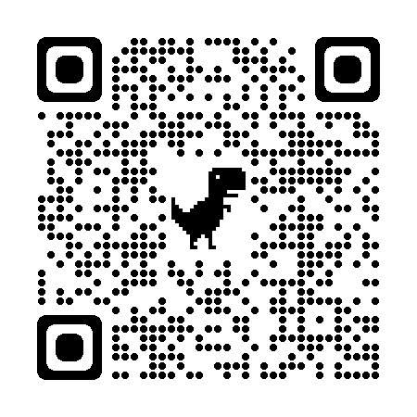
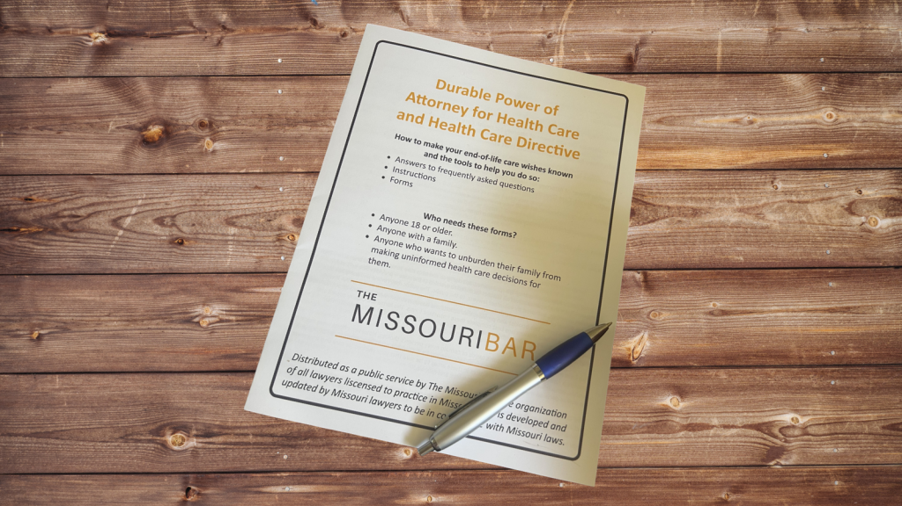
Resources
Mo Bar Association Durable POA

Slide 50
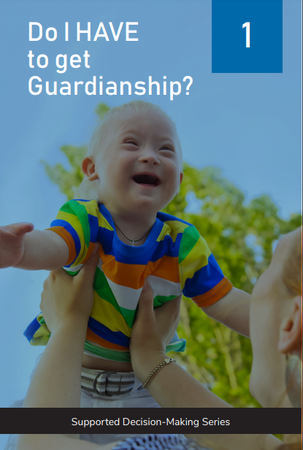
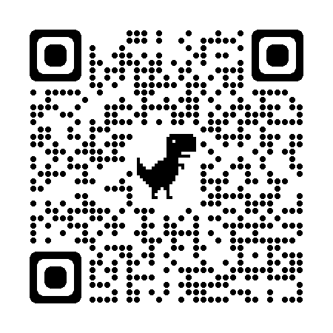
A Power of Attorney (“POA”) is a legal document which enables an individual (the “principal”) to MODDC Supported Decision Making Resources
ed or incapacitated.
A POA gives another person (the attorney in fact) the power to act in the principal’s place and on the principal’s behalf to manage the
principal’s assets and affairs.
A principal may name two or more attorneys in fact who can be authorized to act either "jointly" or "severally“ (alone without the signature of the other )

Slide 51
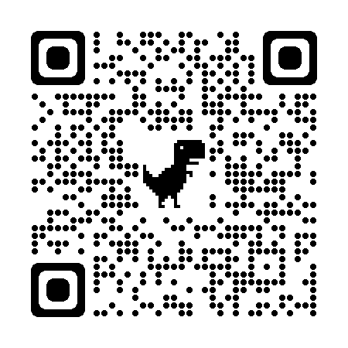
Show Me Rights

Slide 52
Support Available
email: face@ssdmo.org
SSD YOUTUBE PLAYLIST - FACE WORKSHOPS

